Slide 1
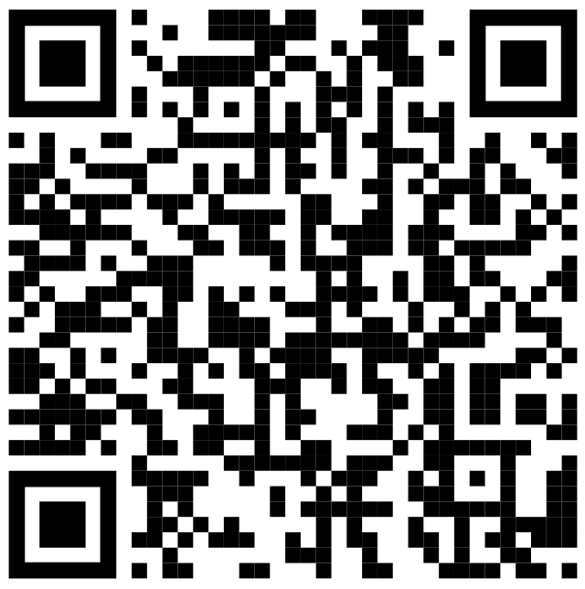
T-SQL - Beyond the Basics
https://github.com/BarneyLawrence
/Sessions-TSQL-BeyondTheBasics
Barney Lawrence
@SQLBarney

Slide 2
About Me

Slide 3
Why?

Slide 4
Content
SSMS Tips and Tricks
Common Table Expressions
Apply Operator
Window Functions
Pivoting
Unpivoting
Putting It All Together

Slide 5
SSMS - Options

Slide 6
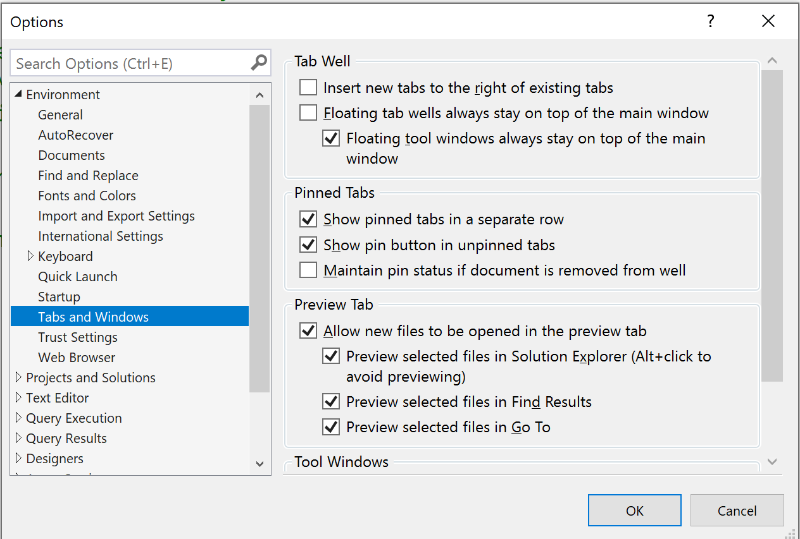

Slide 7
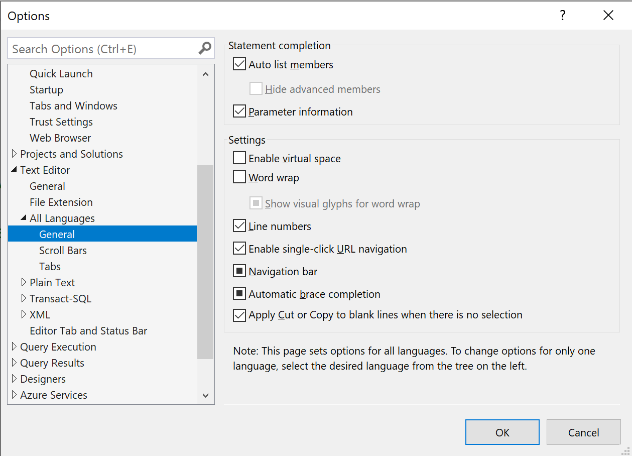

Slide 8
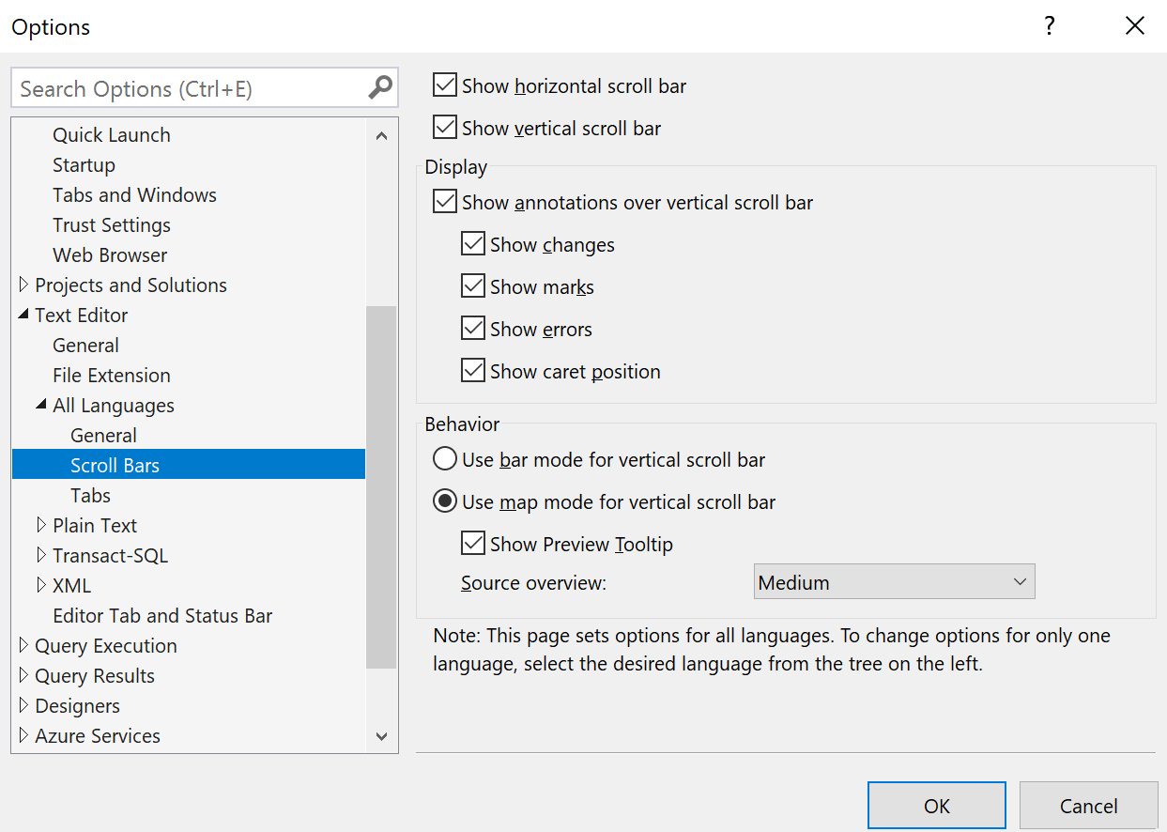

Slide 9
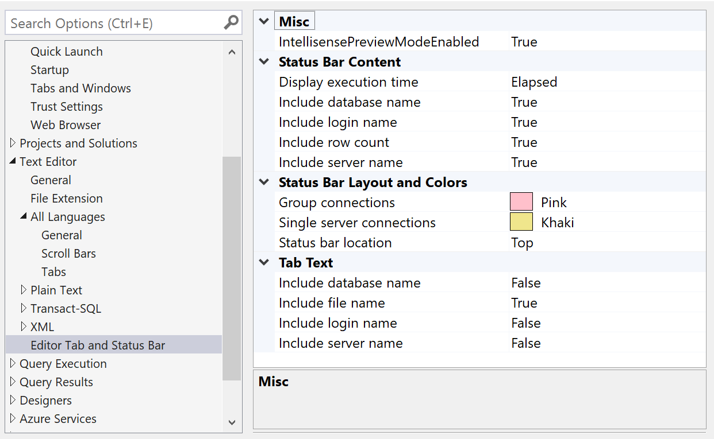

Slide 10
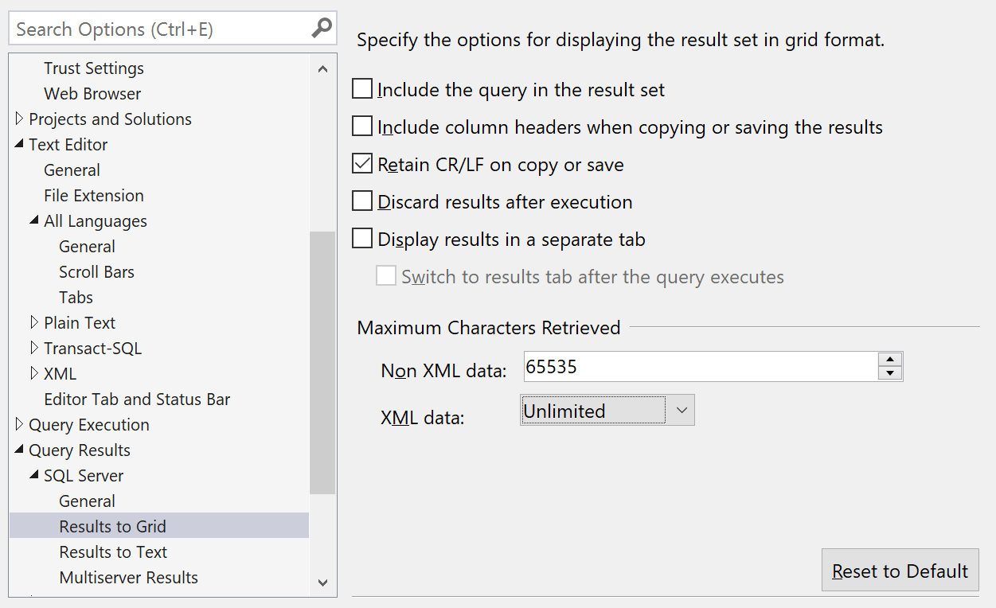

Slide 11
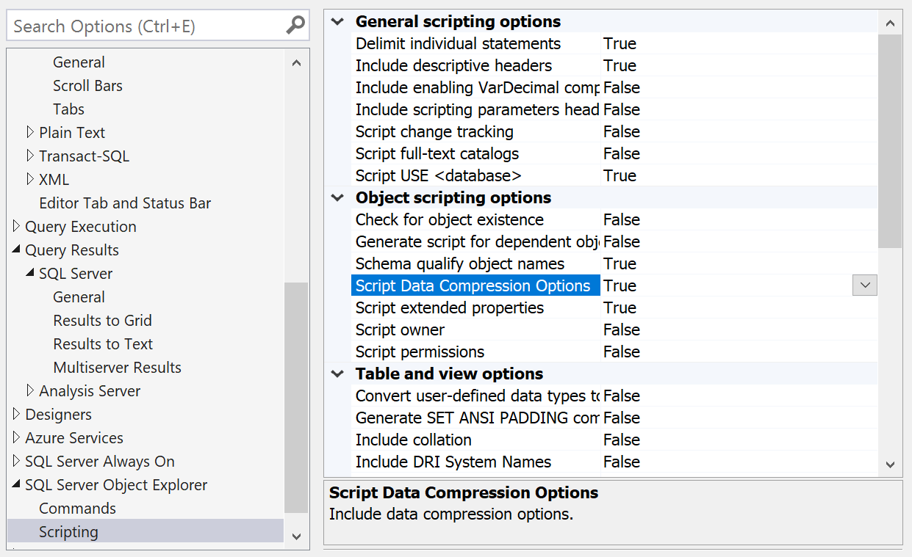

Slide 12
SSMS - Custom Keyboard Shortcuts

Slide 13
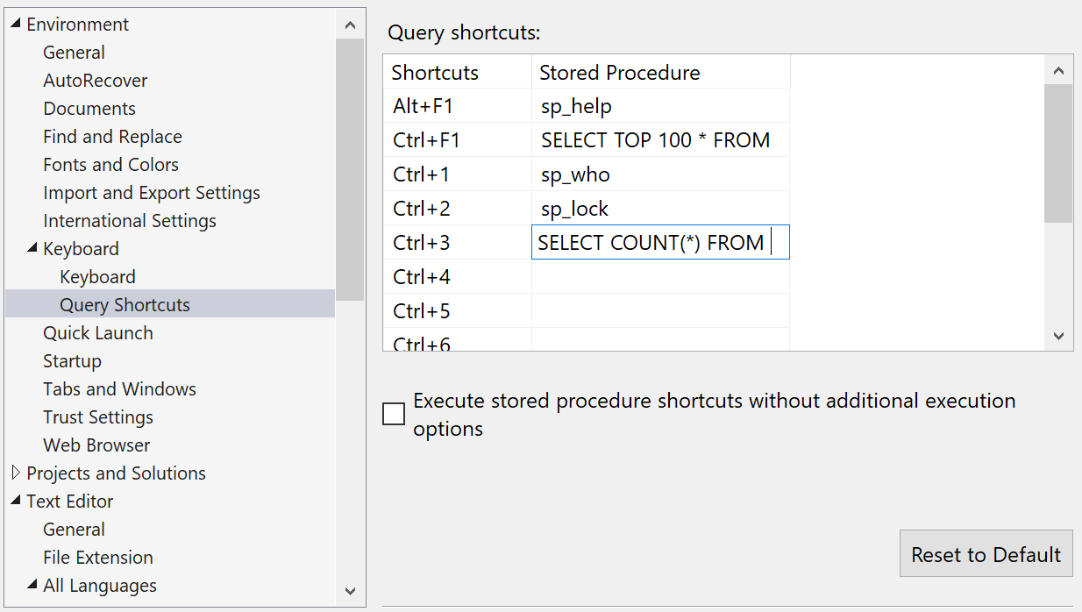

Slide 14
SSMS – Alt Key

Slide 15
Common Table Expressions

Slide 16
APPLY

Slide 17
Window Functions

Slide 18
Pivoting

Slide 19
Unpivoting

Slide 20
Putting It All Together

